Slide 1
Principles of blood transfusion
Dr. D T D Warnakulasuriya
Department of Physiology

Slide 2
objectives
At the end of these two lectures you should be able to
State the blood groups ; ABO and Rh.
blood group antigens in each blood group and the antibodies found in individuals with each of the blood groups.
Inheritance of blood groups.
Outline how blood groups can exclude paternity.
Outline the basis for Haemolytic disease of the newborn.
Outline cross matching of blood.
Outline the risks and complications of blood transfusion.

Slide 3
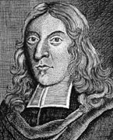
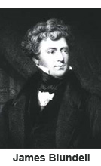
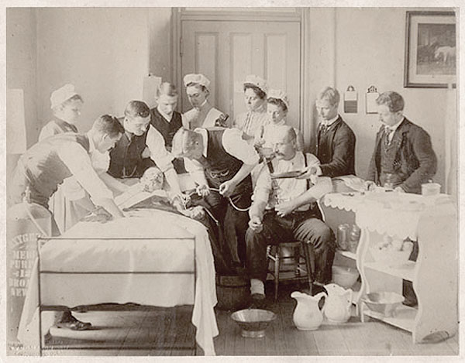
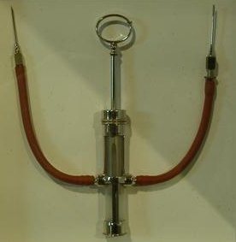
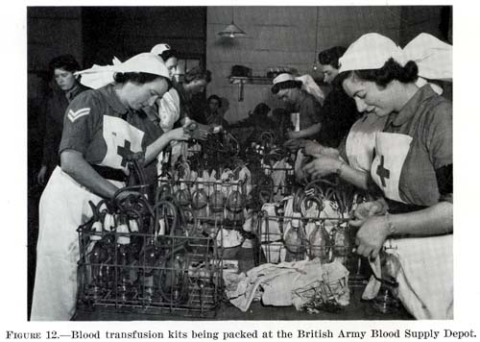
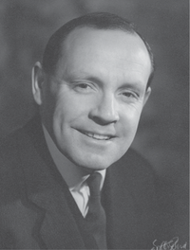
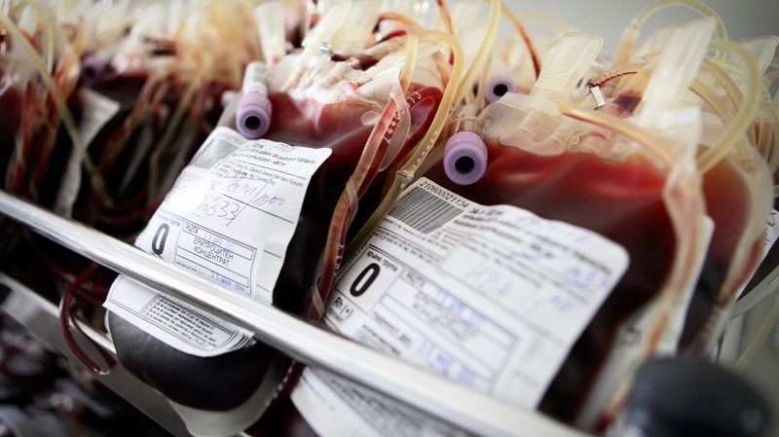
RICHERED LOWER
Notes:
1665- The first recorded successful blood transfusion occurs in England: Physician Richard Lower keeps dog alive by transfusing blood from other dogs.
1818
British obstetrician James Blundell performs the first successful transfusion of human blood to a patient for the treatment of postpartum hemorrhage.
1907
Ludvig Hektoen suggests that the safety of transfusion might be improved by cross-matching blood between donors and patients to exclude incompatible mixtures.
Reuben Ottenberg performs the first blood transfusion using blood typing and cross-matching.

Slide 4
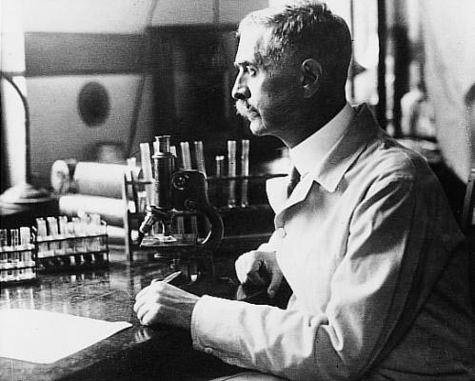
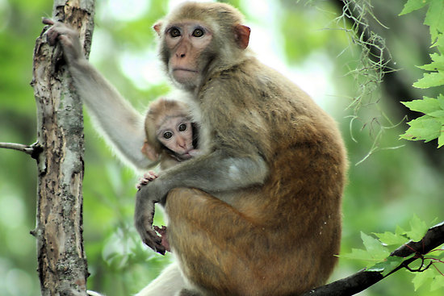
Karl Landsteiner
Rhesus monkeys

Slide 5
History
Many attempts at transfusing animal blood and human blood before the 20th century.
1901- Karl Landsteiner discovered three human blood groups. ( A, B , O)
Awarded the Nobel prize in Physiology and Medicine in 1930.
1902- Alfred von Decastello and Adriano Struli discovered AB blood group.
1940- Rh factor was named by Karl Landsteiner and Alexander Wiener.

Slide 6
1907- Reuben Ottenberg performs the first blood transfusion using blood typing and cross-matching.
Rapid advance in Blood bank services and transfusion practices in world war I
Advanced to component transfusion.

Slide 7
Blood groups
There are 33 known blood groups in humans.
ABO and Rh are the most important.
Other blood groups
Kell
MNS
Lutheran
Kidd
Duffy
Classified by the RBC membrane antigens also called agglutinogens.

Slide 8
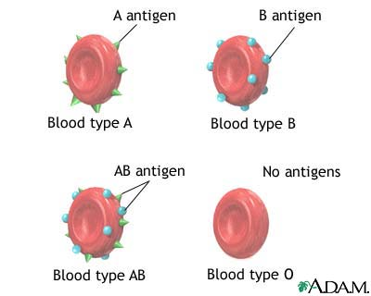
ABO system
4 major blood groups A , B, AB, O.
Inherited as Mendelian Dominance.
The antigens are present in most cells of the body.
All blood groups have H antigen a complex oligosaccharide.
A and B antigens differ in their terminal sugars.
The expression of different transaminases is the cause.
Only
H

Slide 9
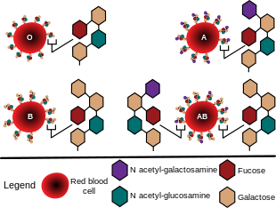
Blood Group | Agglutinogen | Frequency
O | None | 47%
A | A | 45%
B | B | 9%
AB | A and B | 3%

Slide 10
Agglutinins
Antibodies against the agglutinogens are called agglutinins.
Antigens similar to A and B are present in gut bacteria and food.
Infants develop IgM antibodies against the antigens not present in their cells.
Blood Group | Agglutinogen | Agglutinin
A | A | Anti-B
B | B | Anti A
AB | A and B | None
O | None | Anti A & Anti-B

Slide 11
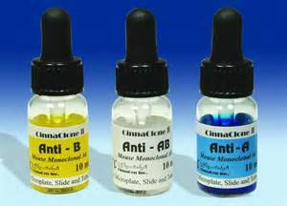
agglutination
When RBC s containing an antigens (eg: A antigen) are mixed with serum containing agglutinins against the antigen ( anti A agglutinins) the RBCs clump.
Used in blood grouping.

Slide 12
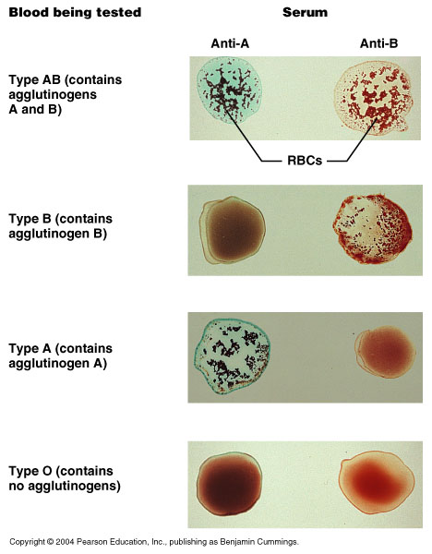
BLOOD GROUPING

Slide 13
Inheritance of ABO blood groups
Mendelian allomorphs
A and B dominant
Useful in paternity testing for exclusion when the mother’s and the child’s blood group is known.
Phenotype (Blood Group) | Genotype
 | Homozygous | Heterozygous
A | AA | AO
B | BB | BO
AB | - | AB
O | OO | -

Slide 14
Alternate ways of writing the genotype
Phenotype | Genotype
A | I^{A}I^{A} or I^{A}i
B | I^{B}I^{B} or I^{B}i
AB | I^{A}I^{B}
O | ii

Slide 15
Rhesus grouping
Antigen first studied extensively in Rhesus monkeys.
Antigen only found on RBC.
Mainly composed by C, D, E , c, d and e antigens.
D is the most antigenic.
Rh positive = D antigen positive
Rh typing is done with anti D agglutinin

Slide 16
Prevalence of RH blood groups
Asians 99% Rh positive
Caucasians 85% Rh positive
Agglutinins do not form naturally, exposure to Rh positive blood is essential.
Eg: Blood transfusion, placental transfusion.

Slide 17
Summery
Classified by the RBC membrane antigens.
Mainly composed by C, D, E antigens;D Antigen is the most antigenic.
Agglutinins for ABO form naturally where as agglutinins for D antigen need exposure of D antigen positive RBCs.
Blood Group | Agglutinogen | Agglutinin
A | A | Anti-B
B | B | Anti A
AB | A and B | None
O | None | Anti A & Anti-B

Slide 18
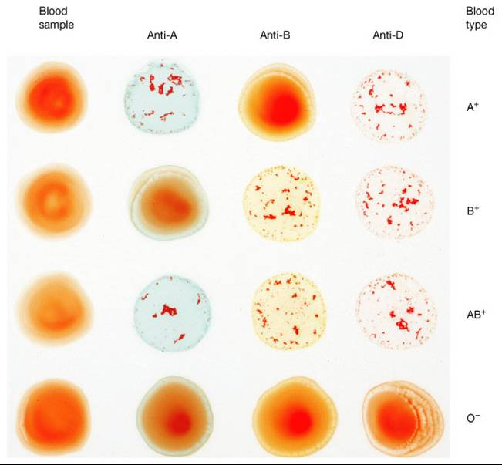
Question: Identify each blood group and right the genotype

Slide 19
haemolytic disease of the newborn
When a Rh negative mother carries a Rh positive fetus, fetal blood can enter the maternal circulation at delivery.
Mother develop Rh agglutinins. ( IgG antibodies)
In the subsequent pregnancies( 2nd, 3rd etc. ) these IgG antibodies will cross the placenta.
If the fetus is again Rh positive these antibodies will cause hemolysis of the fetal RBCs.
This is the underlying pathophysiology of HDN/Erythroblastosis fetalis.

Slide 20
HDN cont.
During fetal life the placental circulation will direct the bilirubin to the maternal circulation and it will be eliminated by the mother’s liver.
In mild cases the newborn will develop jaundice within the first 24 hours as the liver is not mature enough to conjugate the bilirubin.
In severe cases there will be severe anemia, severe jaundice and hydrops fetalis.
As the blood brain barrier of the neonate is immature there will be deposition of unconjugated bilirubin in basal ganglia resulting in kernicterus.

Slide 21
Prevention
Single dose of anti Rh antibodies ( Rhogam) given with in 72 hours to suppress the immune response against Rh positive RBCs.
Reduce sensitization by 90%.

Slide 22
Indications for Rhogam
If there is any risk of feto-maternal hemorrhage during the pregnancy eg: threatened miscarriage, amniocentesis, ahorionic villous sampling.
Anti partum administration of Rhogam at 26 weeks to 28 weeks is done routinely in other countries.
Abortion beyond 13 weeks of gestation.
Post partum( if newborn is Rh positive)

Slide 23
Other causes for hemolytic disease of the newborn
ABO incompatibility
Minor blood group incompatibility

Slide 24
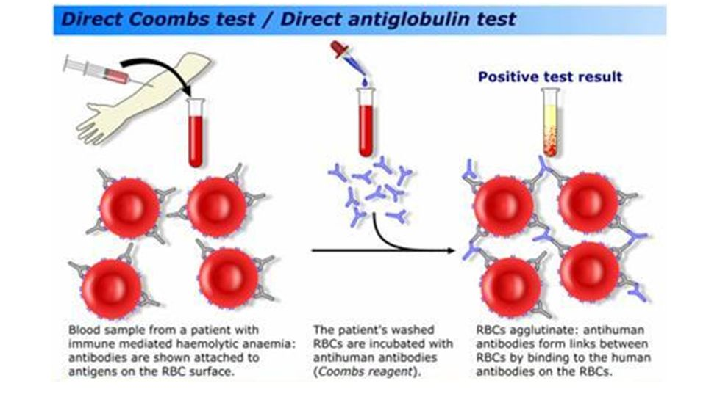
Direct coombs test

Slide 25
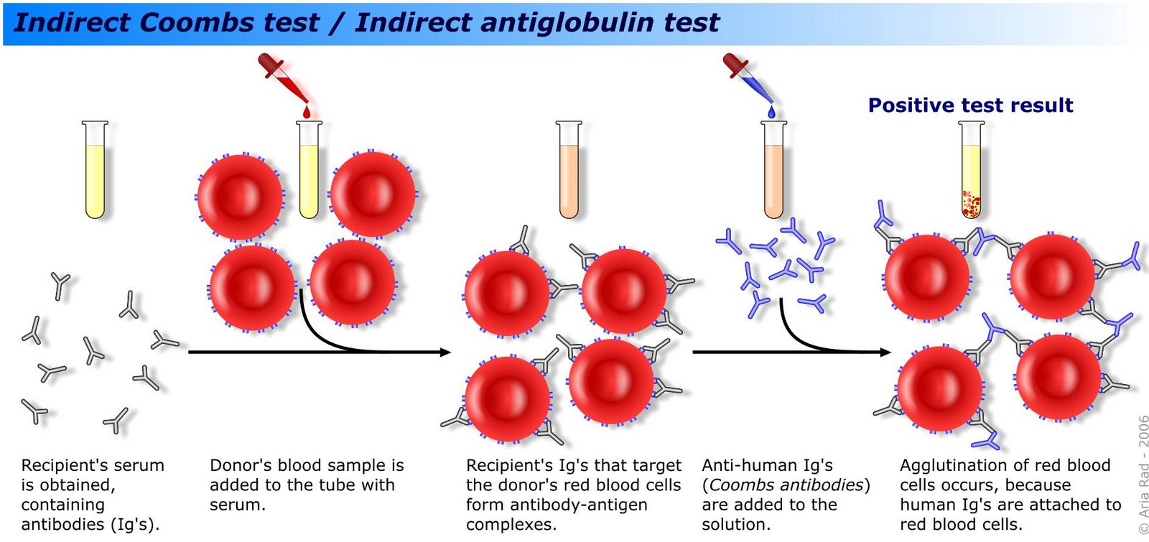
Indirect coombs test

Slide 26
Q.
In which instances would you do Indirect coombs test?

Slide 27
Procedure of Blood transfusions
The aim is to eliminate/minimize transfusion reactions.
Identifying the blood samples correctly is very important.
ABO and Rh grouping of the patients blood is done.
Antibody screening of the patients serum is done in developed centers.
Selection of donor blood from the same ABO and RH group.
Cross matching of patients and donors blood.
( recipients serum with donors blood)
Notes:
Antibody screening- Pts seerum with RBC of group O with a range of known Ags
Cross matching – pts serum with donor RBCs
Optimally pts RBC with Donor serum.

Slide 28
Complications of blood transfusion
Immunological
Hemolytic transfusion reactions
Immediate
Delayed
Urticaria
Febrile transfusion reactions
Post transfusion purpura
Graft Vs Host disease
Transfusion related acute lung injury
Anaphylaxis

Slide 29
Non-immunological complications
Transmission of infections
Viral: HBV, HCV, HIV, HTLV
Bacteria: Yersinia Enterocolitica
Parasites : Malaria
Prions

Slide 30
Autologous Transfusions
Prevent transfusion reactions and minimize complications due to transfusions.
Predeposit preoperatively, blood salvaging can be done intra-operatively.

Slide 31
Blood products and components.
Complications due to transfusions are high when whole blood is transfused.
Component transfusion will benefit the patient in minimizing these complications.
Blood products- Single door, simple separation.
Red cell concentrates, washed red cell concentrates.
Platelet concentrates
Granulocyte concentrates
FFP
Cryoprecipitate

Slide 32
Blood components
Coagulation factor concentrates.
Albumin
Immunoglobulin:
normal
specific( Anti D, anti Hep B, Anti VZV)

Slide 33
Q
A new born baby developed yellowish discoloration of skin and sclera on the 3rd day of life. On investigation his unconjugated bilirubin was elevated. His haemoglobin concentration is 10.8g/dL. Baby’s blood group was O positive and mother’s blood group was A positive. The direct Coomb test was positive in baby’s blood.
What is the most likely cause for the jaundice in this new born. [05 marks]
Explain the basis for the hemoglobin concentration observed in him. [20 marks]

Slide 34
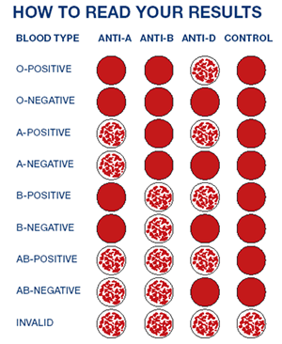
ABO and Rh grouping

